Slide 1
Sub Assembly Data Structure
Process Improvement

Slide 2
Areas Of Improvement
Incomplete ERP BOM
Component/raw material issuance from store
Reservations of unused serials in MOs
Duplicate serials
Manual recording of production in ERP
Undefined reporting(summary reports) and limited charts

Slide 3
Current Process
Manual data entry into paper sheets and filing by the technician
The files are used by clerks to enter data into ERP manually
Closing of MOs
Transfer of assemblies from sub assembly location back to stock

Slide 4
Recommendations
Description | Problem statement/Gap | Impact | Recommendations
ERP workflow | There was no documented ERP work instructions | Creation of KPR parts at sub assembly floor led to negative stock in ERP | Training manual step by step for ease of reference
Lack of resources | Initially sub assembly team had no laptops to do MO processing | Backlog pile up | Provide laptops for the team or atleast a clerk with a laptop(depending on the headcount of sub assembly technicians)
ERP BOM | Incomplete ERP BOM / incorrect ERP BOM | Delay in MO processing | Revision of BOM with team before starting production and sign off
Issuance of materials | Manual issuance of material from store | Delay | Barcode Scanner integration in inventory and assembly tracking
Large quantities to manufacture in ERP | MO closing timeout | Delay in MO processing | Currently using 50 units to process MOs/set a maximum production order
Reservations of unused serials | The system reserved unused serials |  | Configure the system to reserve what have been issued from stor Customize reservations module to issue according to anticipated serials
Duplicate serials | There were a number of cases where serials were repeated |  | Configure the system not to allow entry of same serial numbers
Manual data entry during MO processing | Time Consuming Manual Process | Delay | Barcode scanner integration in inventory and assembly tracking
Reporting | Undefined reporting and limited charts |  | customize reports

Slide 5
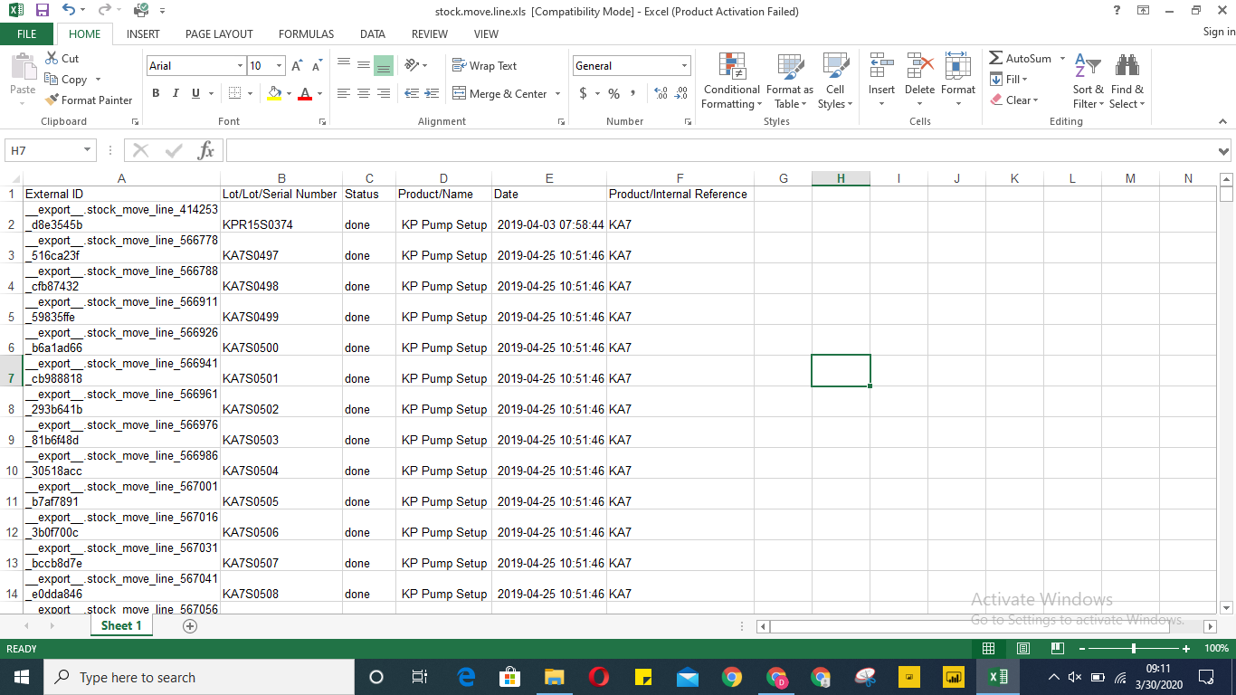
Additional field required
Name of assembly technician should be added as another field alongside responsible which represents the supervisor incharge

Slide 6
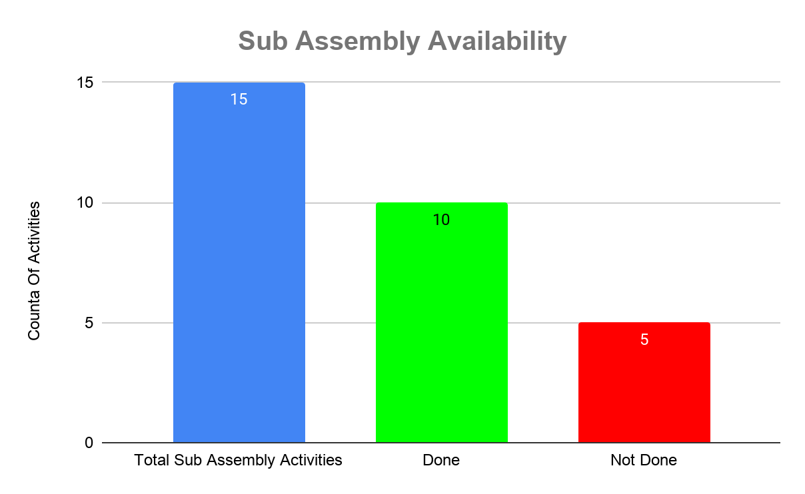
Recommended Sample Reports
Level 1 chart that shows availability of sub assemblies*
Total sub assemblies -are the total number of sub assembly activities that goes into a KOKOpoint
Done-represent total sub assemblies activities that have at least 1 assembled item
Not Done- is the total activities that were not assembled even a single item
*see parameters next slide

Slide 7
Parameters
Name of product/sub assembly activity/internal reference code
Total number of products/sub assembly activities
Date assembled
Name of assembly technician
Assembly status(scheduled,complete/done,incomplete)

Slide 8
Cont.
Sub Assembly | COUNTA of Sub Assembly Activities
KA10 | 1
KA11 | 1
KA12 | 1
KA13 | 1
KA14 | 1
KA15 | 1
KA16 | 1
KA17 | 1
KA18 | 1
KA19 | 1
KA20 | 1
KA21 | 1
KA22 | 1
KA23 | 1
KA9 | 1
Grand Total | 15
Sub Assembly | COUNTA of Sub Assembly Activities
KA10 | 1
KA11 | 1
KA12 | 1
KA13 | 1
KA15 | 1
KA16 | 1
KA18 | 1
KA19 | 1
KA21 | 1
KA9 | 1
Grand Total | 10
Total Sub Assembly Activities | Done | Not Done
15 | 10 | 5

Slide 9
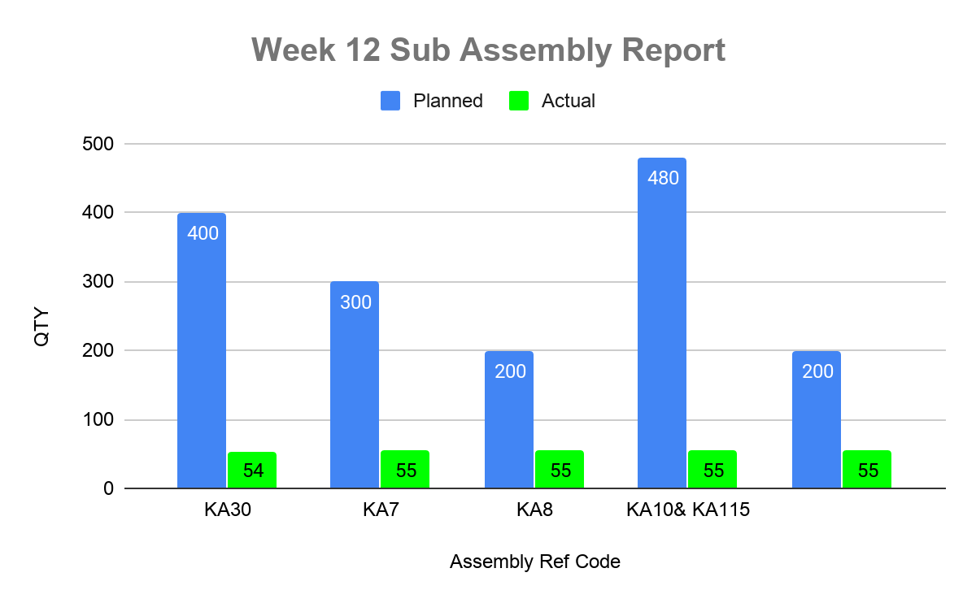
Sample Weekly Report/Chart
Level 2 chart to show weekly sub assembly progress
See parameters next slide

Slide 10
Parameters
Name of product/sub assembly activity
Total number of products/sub assembly activities
Date assembled
Name of assembly technician
Planned quantity per sub assembly(quantity to produce)
Quantity produced per sub assembly
Assembly status(scheduled,complete/done,incomplete)

Slide 11
Weekly Output Summary
 | Weekly Total
Assembly Name/Ref Code | Planned | Actual
KA9 | 400 | 54
KA30 | 300 | 55
KA7 | 200 | 55
KA8 | 480 | 55
KA10& KA115 | 200 | 55
PLANNED- Cumulative total per week per activity
ACTUAL-Cumulative total per week per activity

Slide 12

Thank you.

